Slide 1
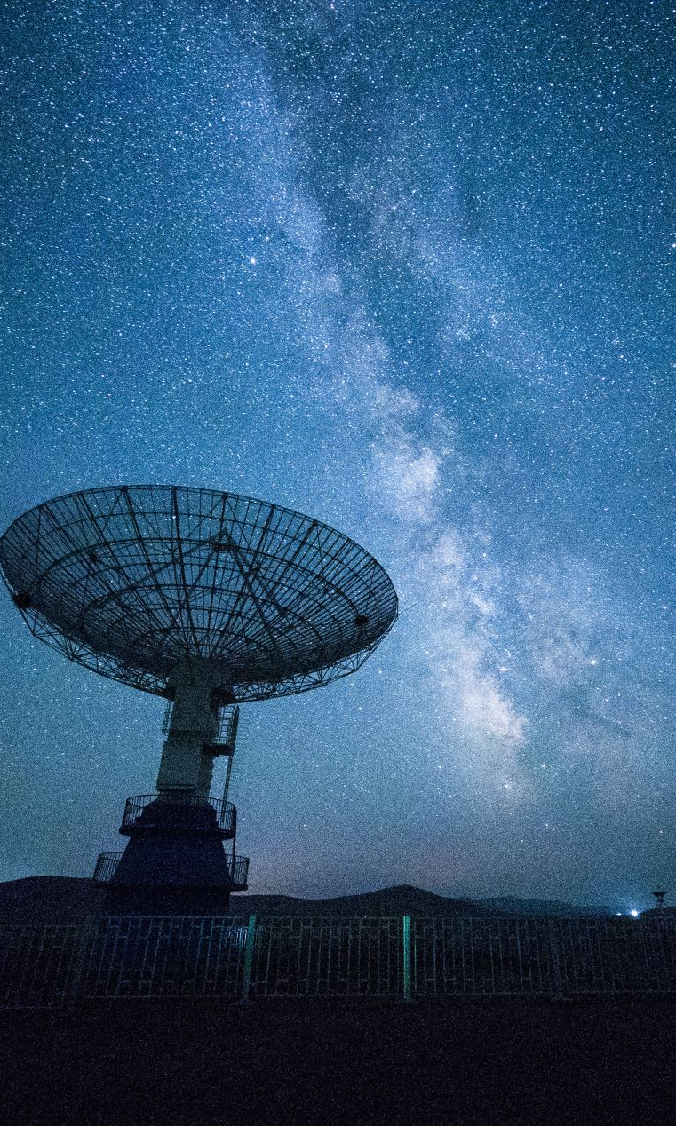
The Milky Way and its Millisecond Pulsar Population
Shiyang Zhang, Arend Moerman,
Erwan Hochart

Slide 2
Aim: To research the possibility of an exotic millisecond pulsar population within the Milky Way

Slide 3
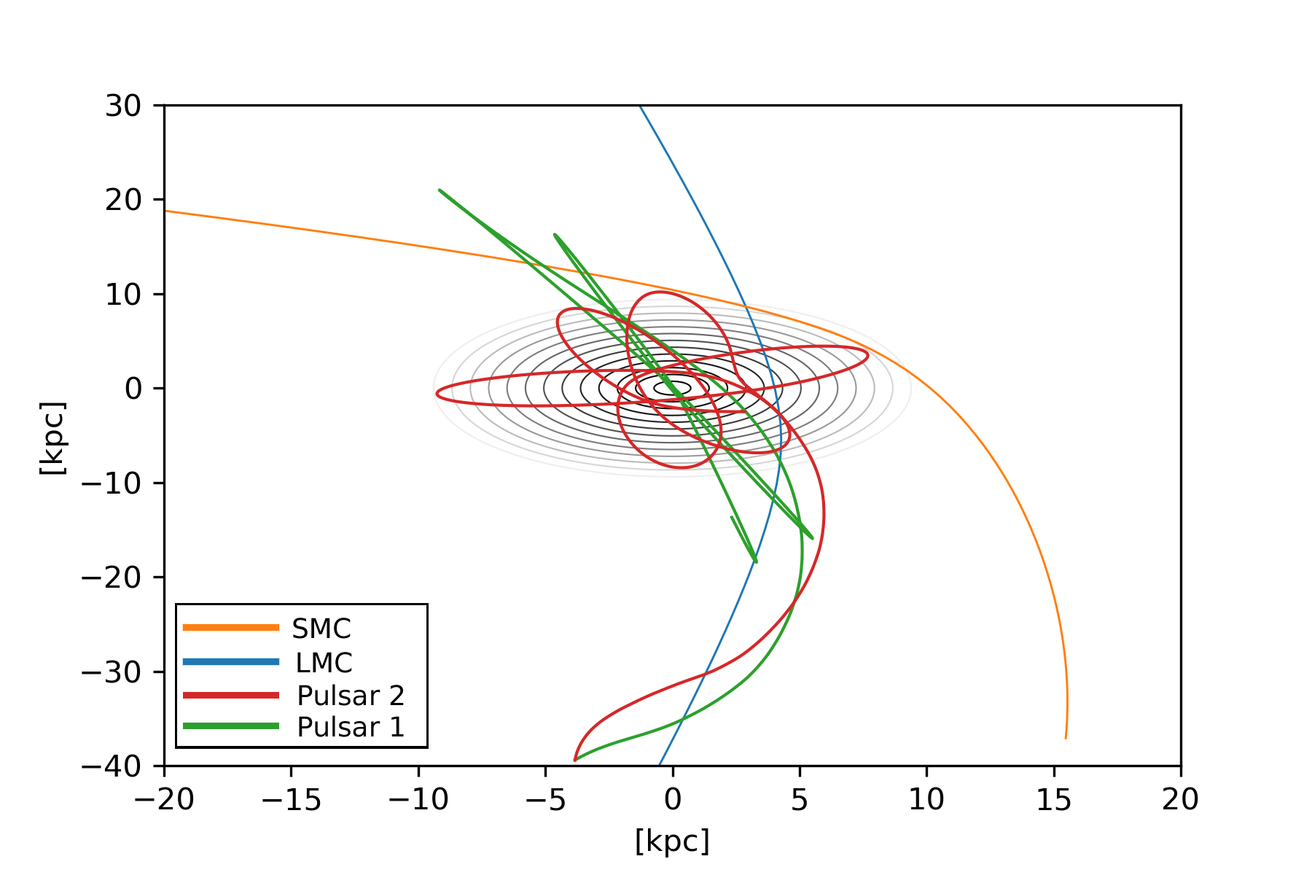
Overview
Millisecond Pulsars: What are they?
Sampled Millisecond Pulsar Population
Birth Rate
Velocity Distribution
Mass Distribution
The Code
Gravitational Potentials
The general methodology
The Results
Future Research

Slide 4
Overview
Millisecond Pulsars: What are they?
Sampled Millisecond Pulsar Population
Velocity Distribution
Birth Rate
Mass Distribution
The Code
Gravitational Potentials
The general methodology
The Results
Future Research

Slide 5
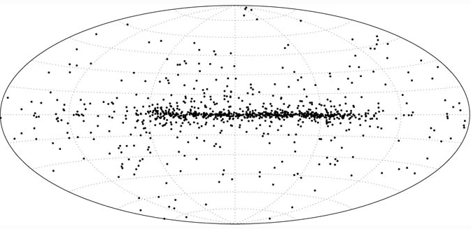
Millisecond Pulsars: What are they?
Supernova event causes significant mass loss
Research targets for a wide range of physics
General Relativity
Planetary Systems
Millisecond pulsars rotate 30 to 700 times per second
Lifetime comparable to the age of the Universe
Image courtesy of Lorimer 2001
1. Millisecond Pulsars: What are they?
Notes:
If they rotate quick enough they will emit electromagnetic radiation since charged particles accelerate along their magnetic field lines and this emission can then be observed by us if it passes our line of sight

Slide 6
Overview
Millisecond Pulsars: What are they?
Sampled Millisecond Pulsar Population
Velocity Distribution
Birth Rate
Mass Distribution
The Code
Gravitational Potentials
The general methodology
The Results
Future Research

Slide 7

Sampled Millisecond Pulsar Population: Velocity Distribution
Only look at a Supernova origin
Distribution based on Hansen and Phinney (1997)
$$P\left(v_{k}\right)=\sqrt{\frac{2}{π}}\frac{{{\overline{v}}_{k}}^{2}}{σ_{v}^{3}}\exp\left[−\frac{v_{k}^{2}}{2σ_{v}^{2}}\right]$$
$σ_{v}=190 km s^{−1}$
${\overline{v}}_{k}=250 km s^{−1}$
Randomised orientation
2.1 Sampled Millisecond Pulsar Population: Velocity Distribution

Slide 8
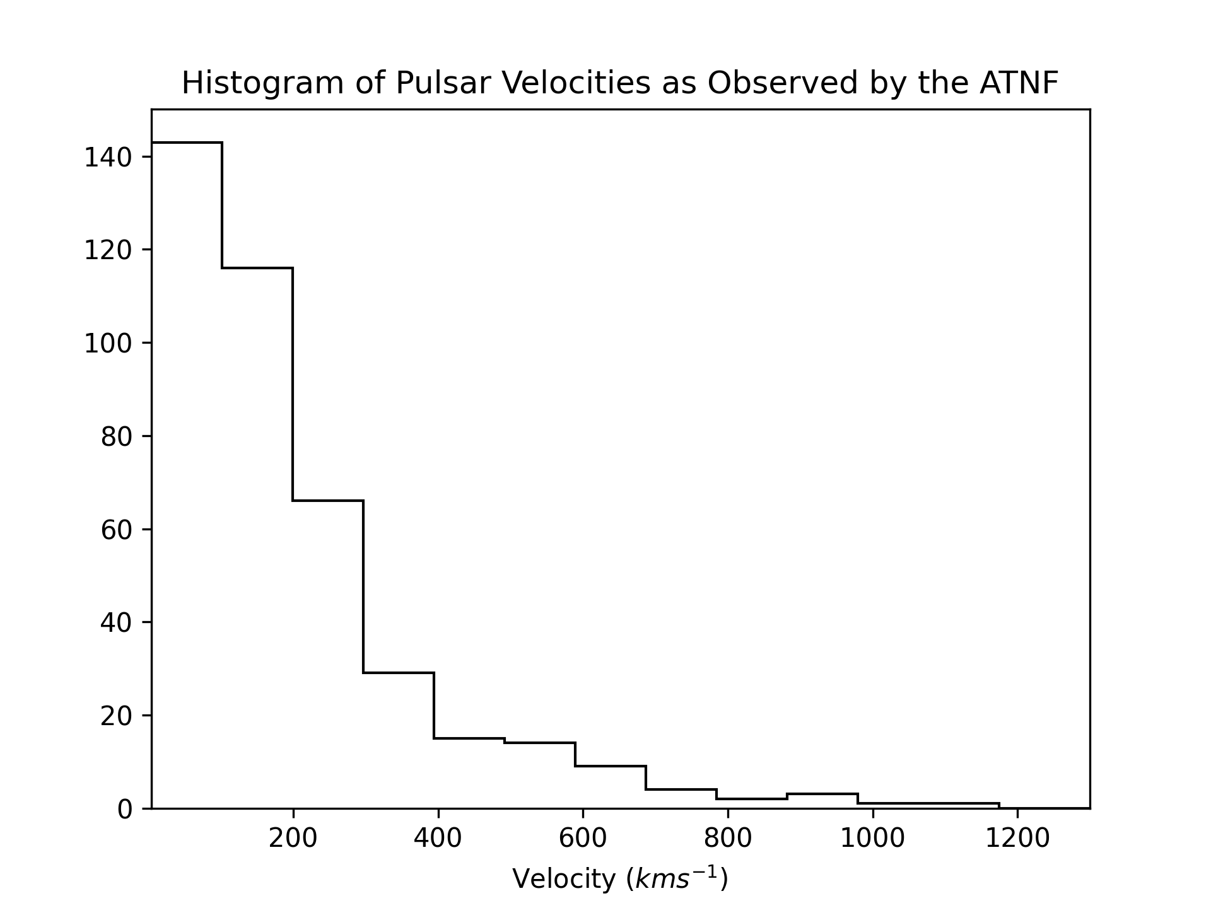
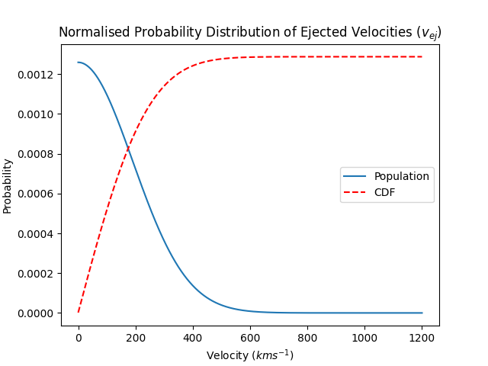
Sampled Millisecond Pulsar Population: Velocity Distribution
Data taken from the Australia Telescope National Facility catalogue (2019)
2.1 Sampled Millisecond Pulsar Population: Velocity Distribution

Slide 9
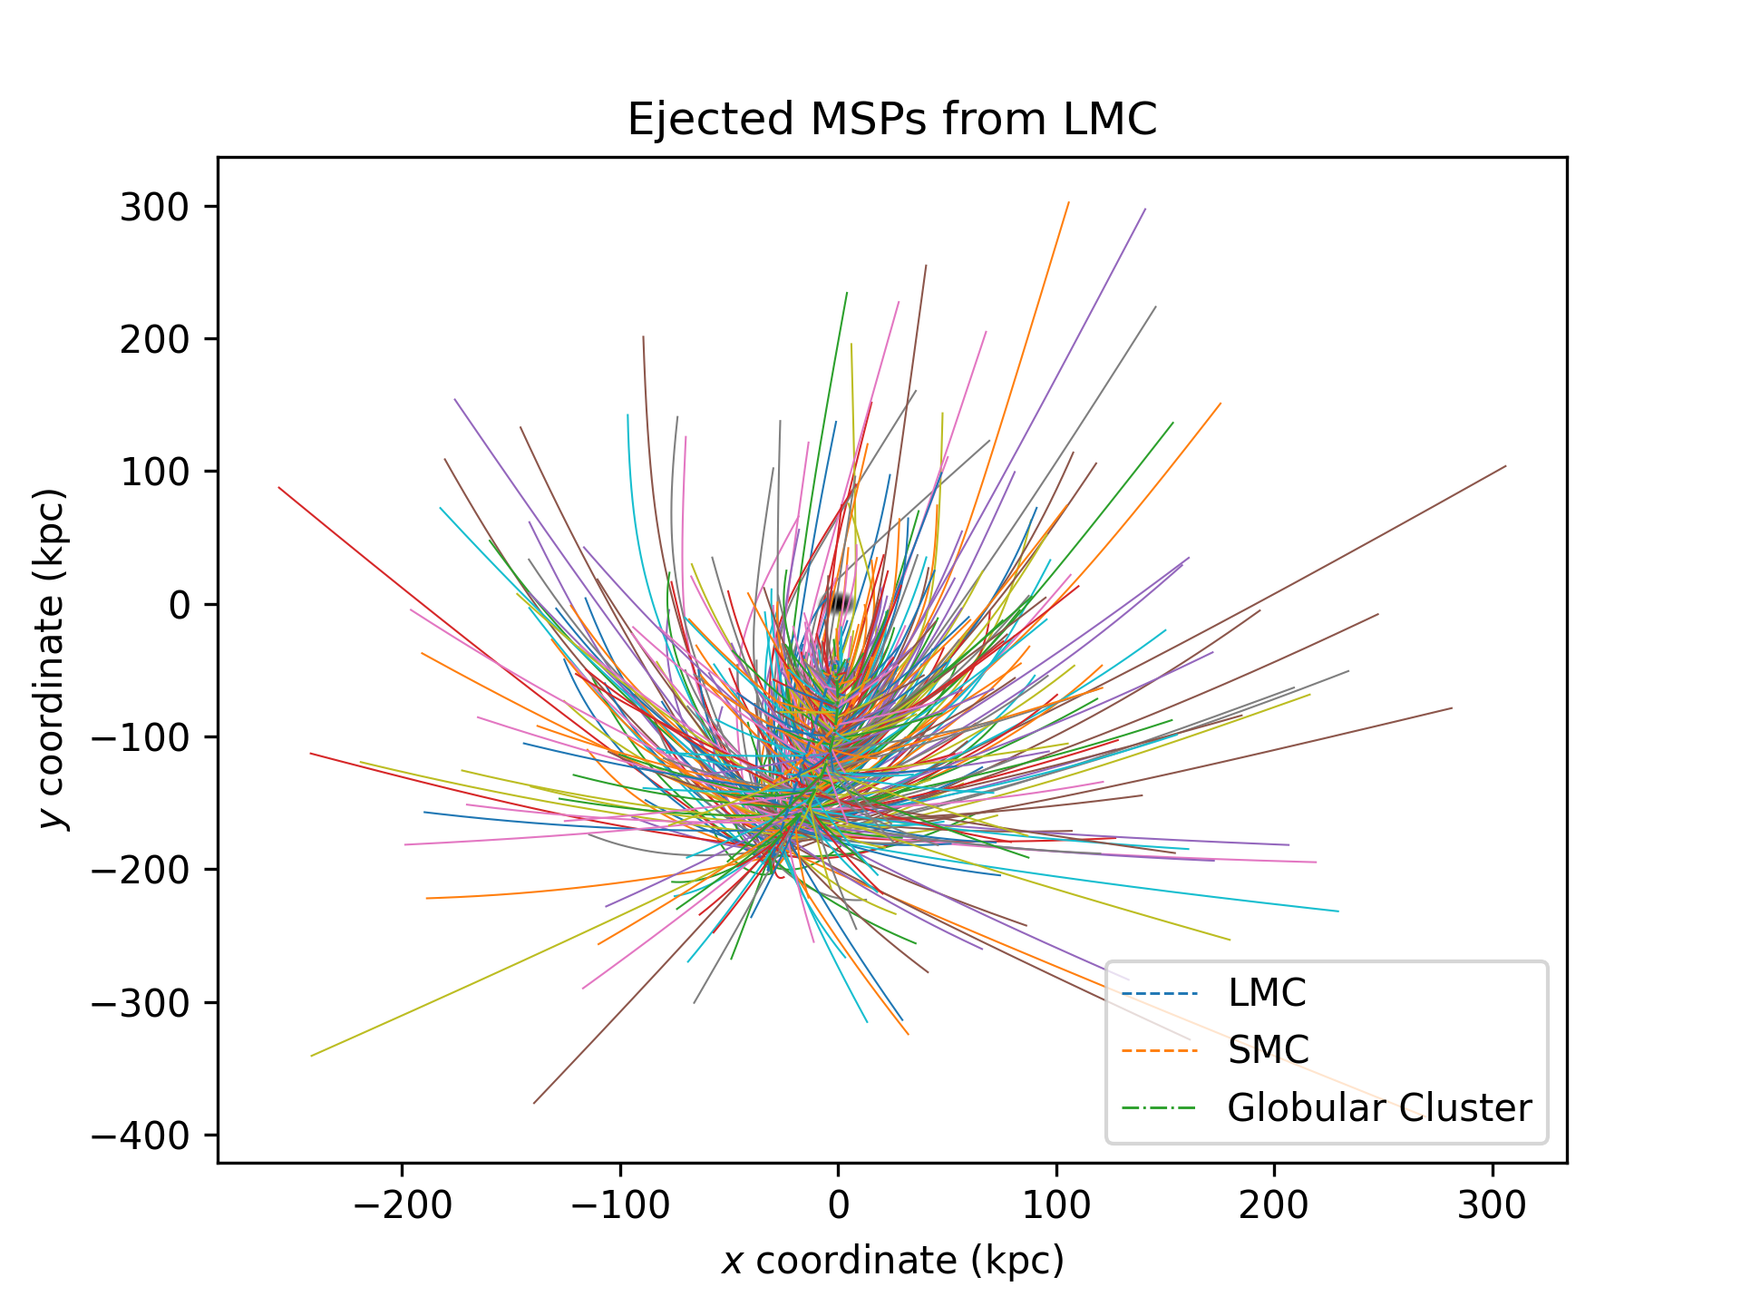
Sampled Millisecond Pulsar Population: Birth Rate
Milky Way birthrate: ~0.05 Myr
LMC birthrate: ~1.80 Myr
SFR of Milky Way and LMC
Incorporate fraction of binary population
Total of 555 ejections per simulation
2.2 Sampled Millisecond Pulsar Population: Birth Rate
Notes:
This was a major assumption in our report as there were no papers found analysing the birthrate of MSP in the LMC
We used the SFR of the MW and LMC of the last 2Gyr and used it as a ratio of their MSP birthrate based on the observed birthrate of the MW
Last 2Gyr because our simulation goes 1Gyr back in time
This gave an original result of a MSP being born every 0.36 Myr but if we incorporate the fact that 20% of them are solitary – which is the population we want as these systems have had a high enough velocity to be ejected from the system, our new birth rate becomes every 1.80 Myr

Slide 10

Sampled Millisecond Pulsar Population: Mass Distribution
Energy conservation code
Neutron stars tend to be $1.4 M_{⊙}$ (Chandresakhar limit)
Millisecond pulsars accrete mass
Data taken from Antoniadis et al. 2016
$\overline{m}=1.4 M_{⊙}$
$σ_{m}=0.3 M_{⊙}$
Gaussian Distribution – Central Limit Theorem
2.3 Sampled Millisecond Pulsar Population: Mass Distribution
Notes:
Three percent of the MSP had masses above 2.1 M_odot but with a maximum mass of 2.15 M_\odot
Used the values given to work backwards and find standard deviation but there was no theorized function so we used a normal distribution based on CLT

Slide 11
Overview
Millisecond Pulsars: What are they?
Sampled Millisecond Pulsar Population
Velocity Distribution
Birth Rate
Mass Distribution
The Code
Gravitational Potentials
The general methodology
The Results
Future Research

